Slide 1
Towards GFem

Slide 2
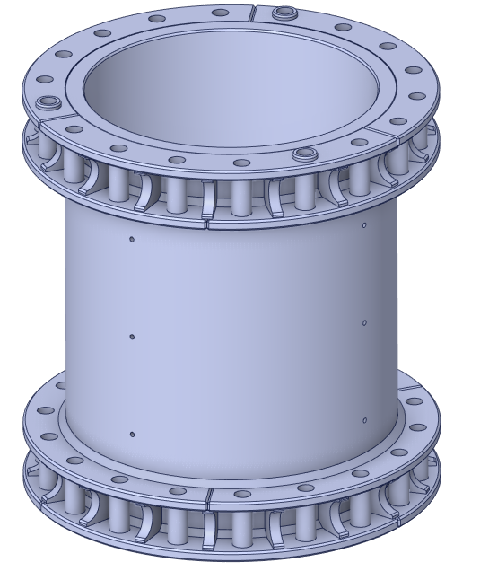
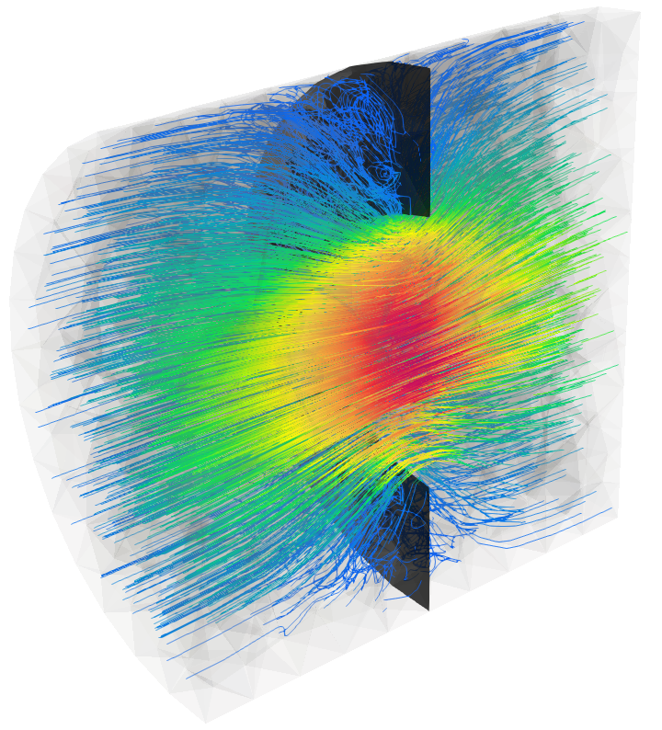
Introduction
Extend NeoPZ to incorporate GFem approximations
NeoPZ basic structure
GFem computational mesh
GFem computational element
Darcy simulation
Elasticity simulation

Slide 3
Extend NeoPZ with Gfem spaces
GFem can be viewed as a strategy for enriching approximations spaces
The H1 background approximation is unchanged
The geometric map is unchanged
One needs to add functions

Slide 4

The NeoPZ environment
PZ
Geometric Map
Approximation Space
Variational Statement
System resolution
H1
Hdiv – Hcurl
Discontinuous
Multi physics
H refinement
Blended map
Refinement patterns
Systems of differential equations
Linear and nonlinear
Matrix storage patterns
Resolution methods
Substructuring
Multigrid
Pre conditioning
Finite Element Tools
Adaptivity
Unit tests
Performance assessment
Developments
Multiphysics simulation
Electro magnetics
Error estimation
https://github.com/labmec/neopz

Slide 5
Extend the computational mesh
A computational mesh TPZCompMesh consists of
Computational elements – TPZCompEl
Computational nodes – TPZConnect
Variational statemenst – TPZMaterial
TPZGFemCompMesh
Map associating a std::function with computational nodes
Keep the datastructure as simple as possible!

Slide 6
Extend the H1 Computational Element
TPZCompElH1 implements an H1 approximation space
ComputeShape
Integration rule
TPZGFemCompElH1 extends the H1 function space
Overloads ComputeShape
For the functions that are extended

Slide 7
Multiphysics approximations
NeoPZ has the capability of combining different approximation spaces into a single simulation
Elasticity + thermal = termo-elastic
Elasticity + fluid flow = Biot
In GFem H1 approximation spaces are combined
H1 computational elements
GFemH1 computational elements

Slide 8
Variational Statement
TPZDarcyFlow implements Laplace’s equation
GFem variational statements allow to combine “n” H1 approximations
TPZGFemDarcyFlow
TPZGFemElasticity2D
TPZGFemElasticity3D

Slide 9
Shape function representation
In H1 approximations it is custom to represent the shape functions and their derivatives
A vector of shape functions
A matrix representing the derivative of these functions
When applied to elasticity each function is used 2 or 3 times to represent the displacements and their derivatives
In GFem approximations shape functions are vector valued

Slide 10
Shape function representation
In GFem approximations shape functions are vector valued
Shape functions are a matrix (nvec x nshape)
Derivatives are a list of tensors (nvec^2 x nshape)

Slide 11
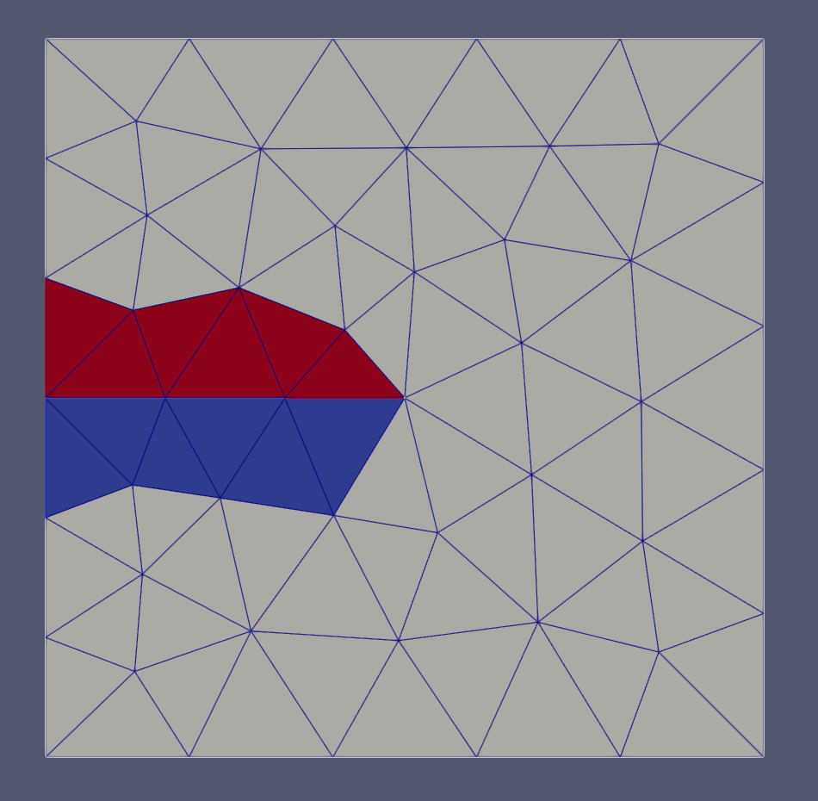
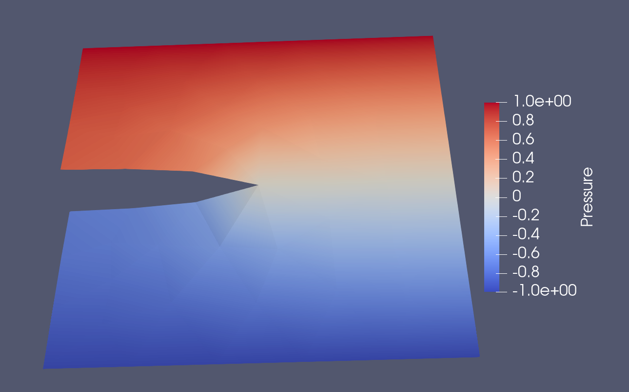
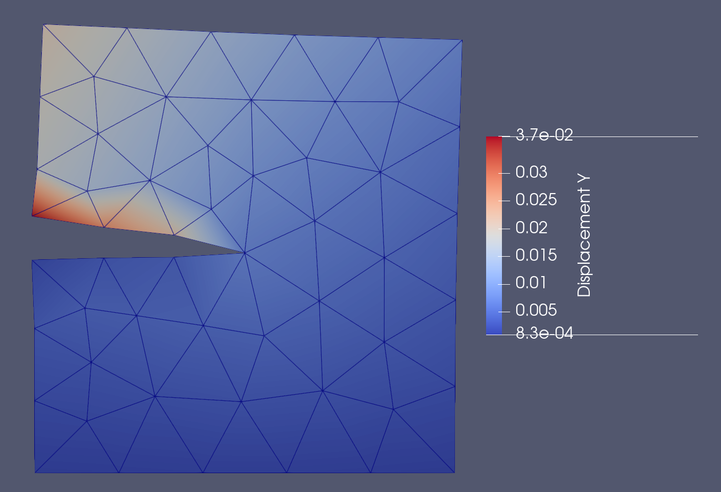
2D simulation
Square domain with mesh aligned fracture
Separating red and blue
elements
Scalar problem
Elasticity problem
No singular functions yet

Slide 12
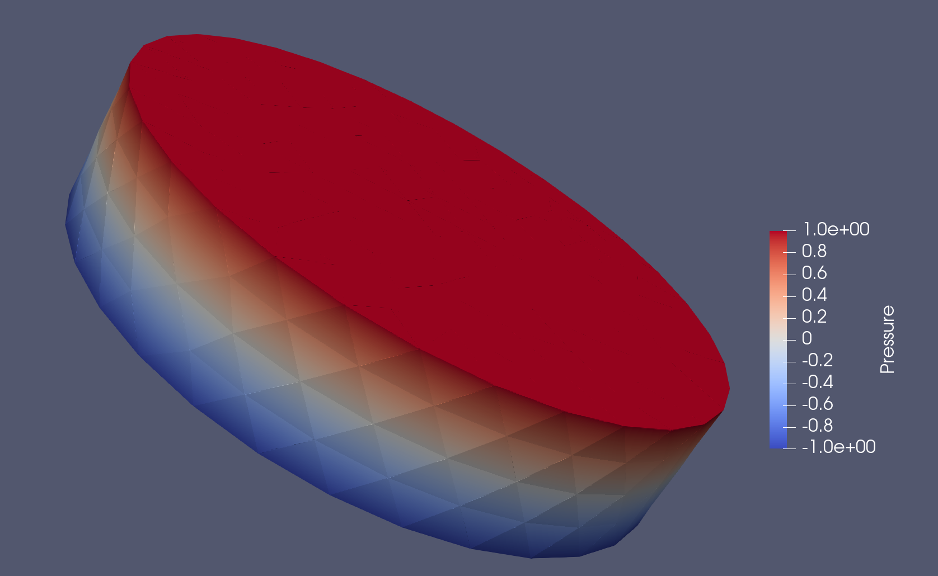
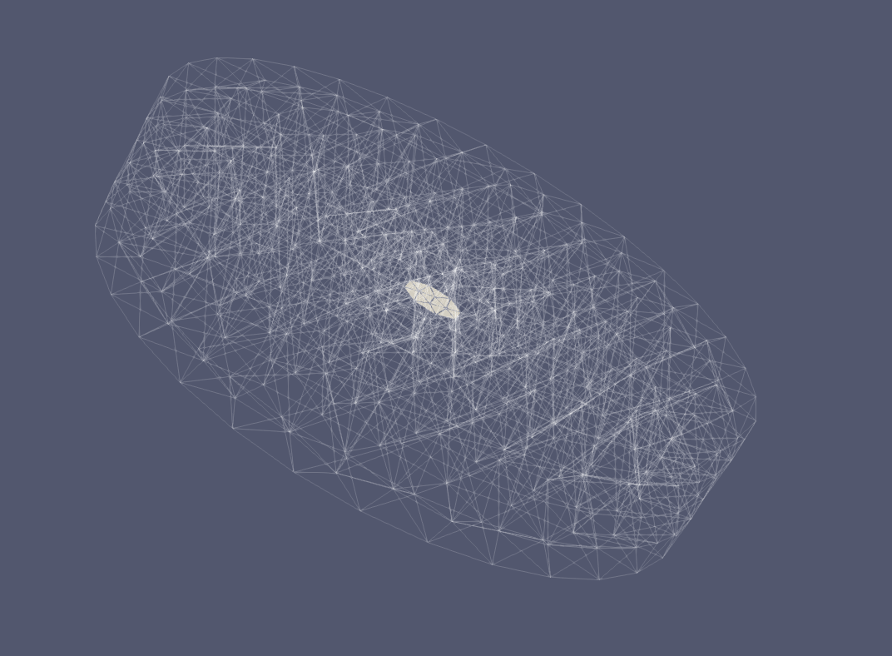
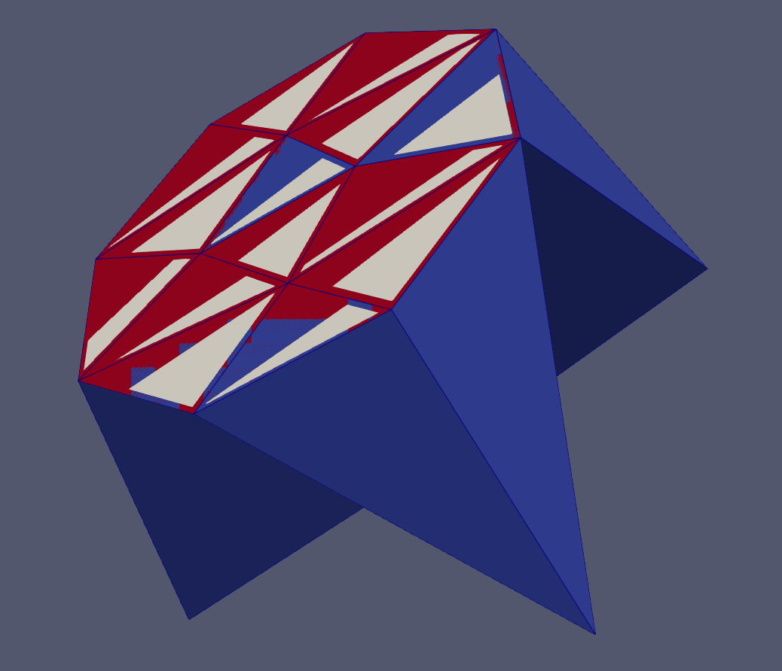
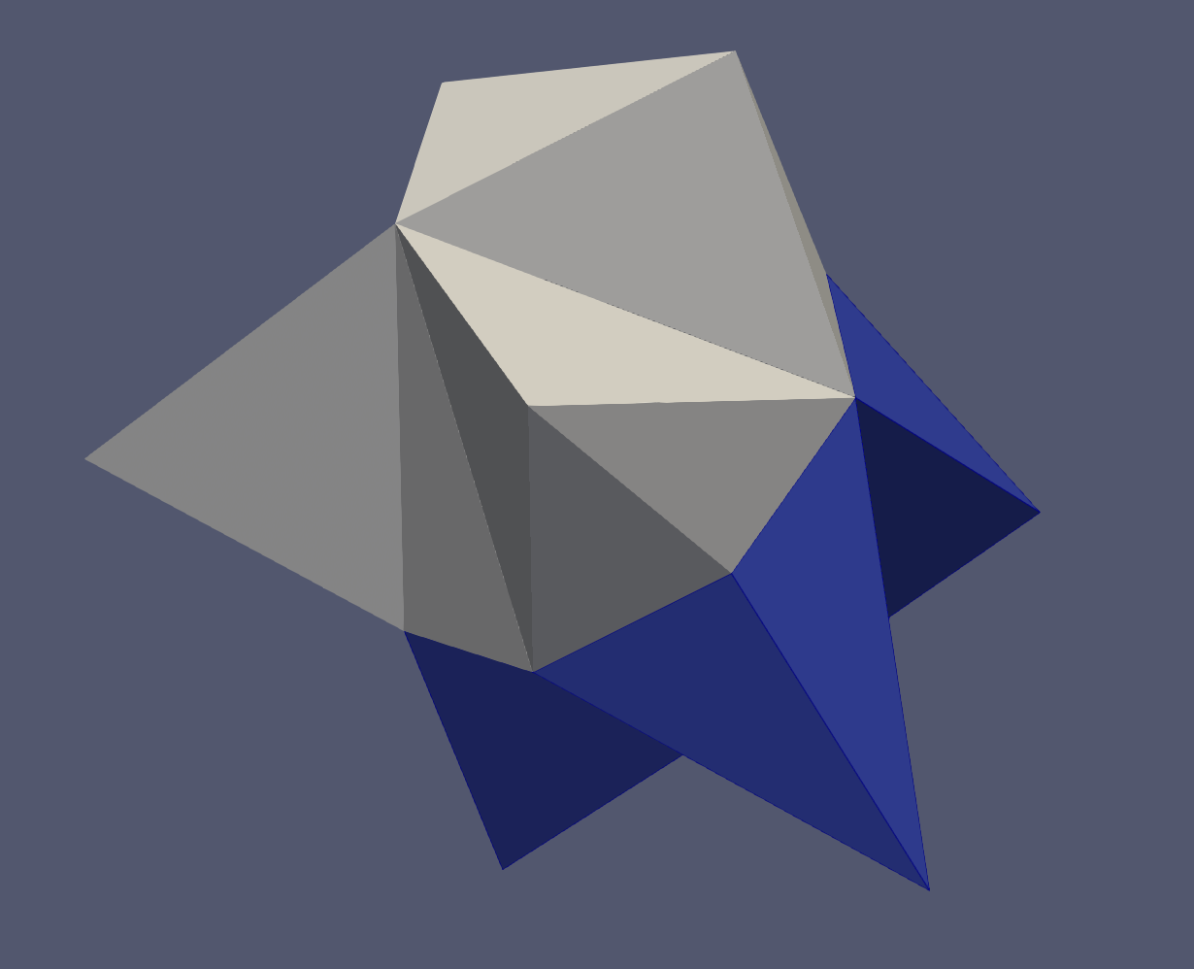
3d simulation
Cilindrical domain with penny shaped internal geometry
Problem setup
Mesh coloring
Gfem elements

